Slide 1
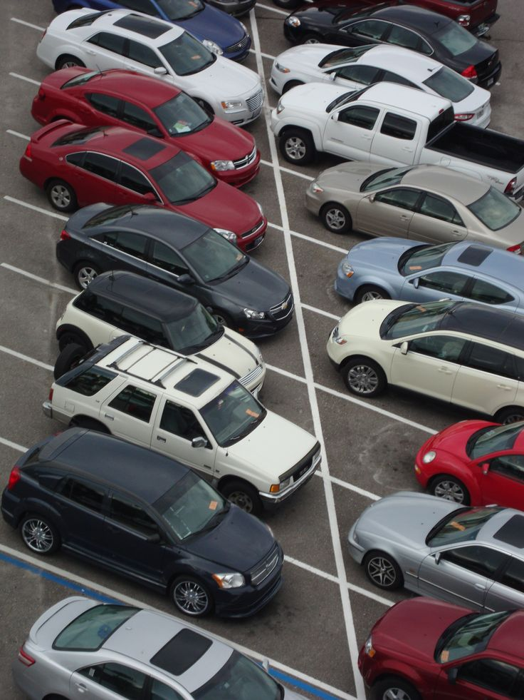
Motor Vehicle Theft Analysis
Pranali Patil
FROM: IT Vedant

Slide 2


Understanding Vehicle Theft Patterns
Project Overview
This comprehensive analysis examines motor vehicle theft patterns using advanced data analytics techniques. By analyzing thousands of theft records across multiple dimensions, we uncover critical insights into vehicle crime trends.
Why This Matters
Crime Prevention: Identify high-risk vehicles and locations to deploy resources effectively
Insurance Intelligence: Enable accurate risk assessment and premium calculations
Policy Development: Inform law enforcement strategies and legislative decisions
Public Awareness: Help vehicle owners make informed security decisions

Slide 3
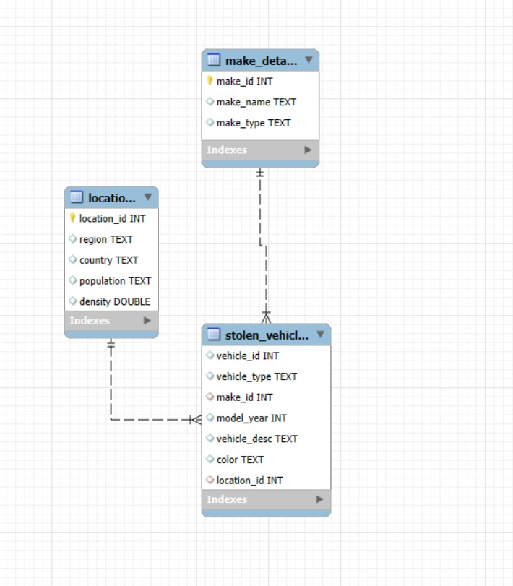



Database Architecture
Stolen Vehicles
Locations
Core table containing vehicle identifiers, theft dates, types, colors, and model years with foreign key relationships
Geographic data including regions, population demographics, and density metrics for spatial analysis
Make Details
Manufacturer information categorizing vehicles by make name, classification, and luxury versus standard designation
The relational database connects stolen_vehicles to locations via location_id and to make_details via make_id, enabling comprehensive multi-dimensional analysis across geographic, temporal, and vehicle characteristic dimensions.

Slide 4

Research Objectives
01
Vehicle Profile Identification
Determine which vehicle types, makes, model years, and colors are most frequently targeted by thieves to establish high-risk profiles
02
Geographic Pattern Recognition
Map regional theft concentrations and identify hotspots where vehicle crime rates significantly exceed national averages
03
Market Segment Comparison
Compare theft rates between luxury and standard vehicles to understand targeting preferences and economic motivations
04
Temporal Trend Analysis
Examine theft patterns over time to identify seasonal variations, emerging trends, and shifts in criminal behavior

Slide 5
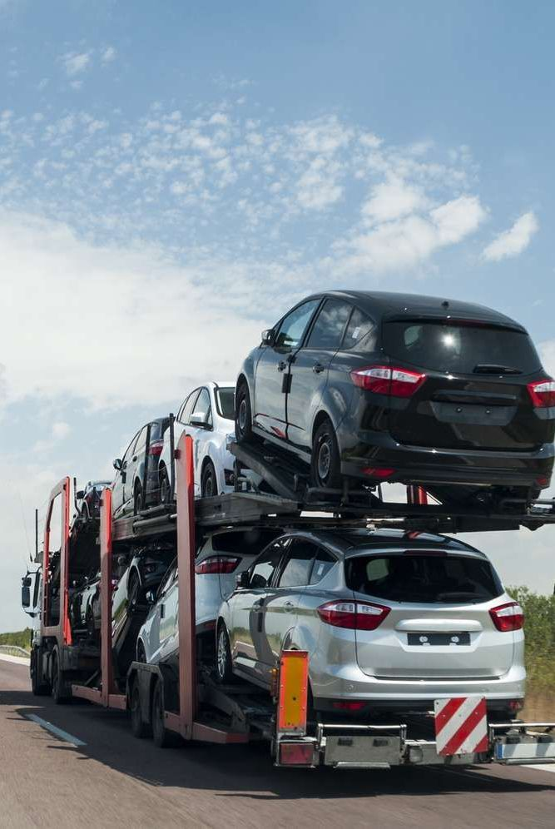
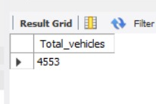
Total Theft Volume
Analysis Query
We begin with a fundamental metric to establish the scope of the vehicle theft problem:
Vehicles Stolen
Total number of motor vehicle theft incidents documented across all regions, timeframes, and vehicle categories
SELECT COUNT(vehicle_id) AS Total_vehicles
FROM stolen_vehicles;
This aggregate count provides our baseline dataset size and reveals the magnitude of vehicle theft incidents recorded in the database.

Slide 6
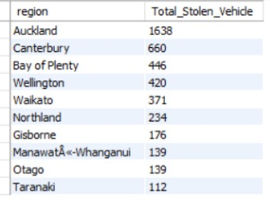
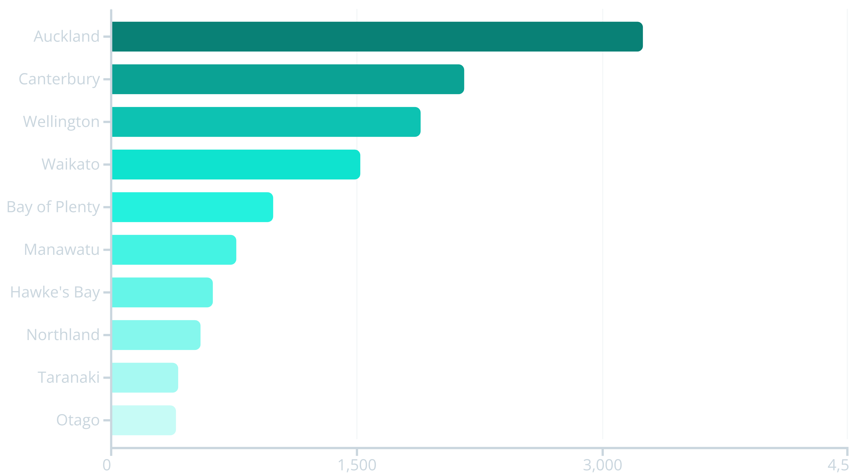
Regional Theft Hotspots
Top 10 Regions by Theft Volume
SELECT region, COUNT(vehicle_id) AS Total_Stolen_Vehicle
FROM stolen_vehicles sv
JOIN locations l
ON sv.location_id = l.location_id
GROUP BY region
ORDER BY Total_Stolen_Vehicle DESC
LIMIT 10;
Key Finding: Auckland dominates with over 3,200 thefts, representing 26% of all recorded incidents. The top three regions—Auckland, Canterbury, and Wellington—account for nearly 60% of total vehicle thefts, indicating significant geographic concentration in major metropolitan areas.

Slide 7
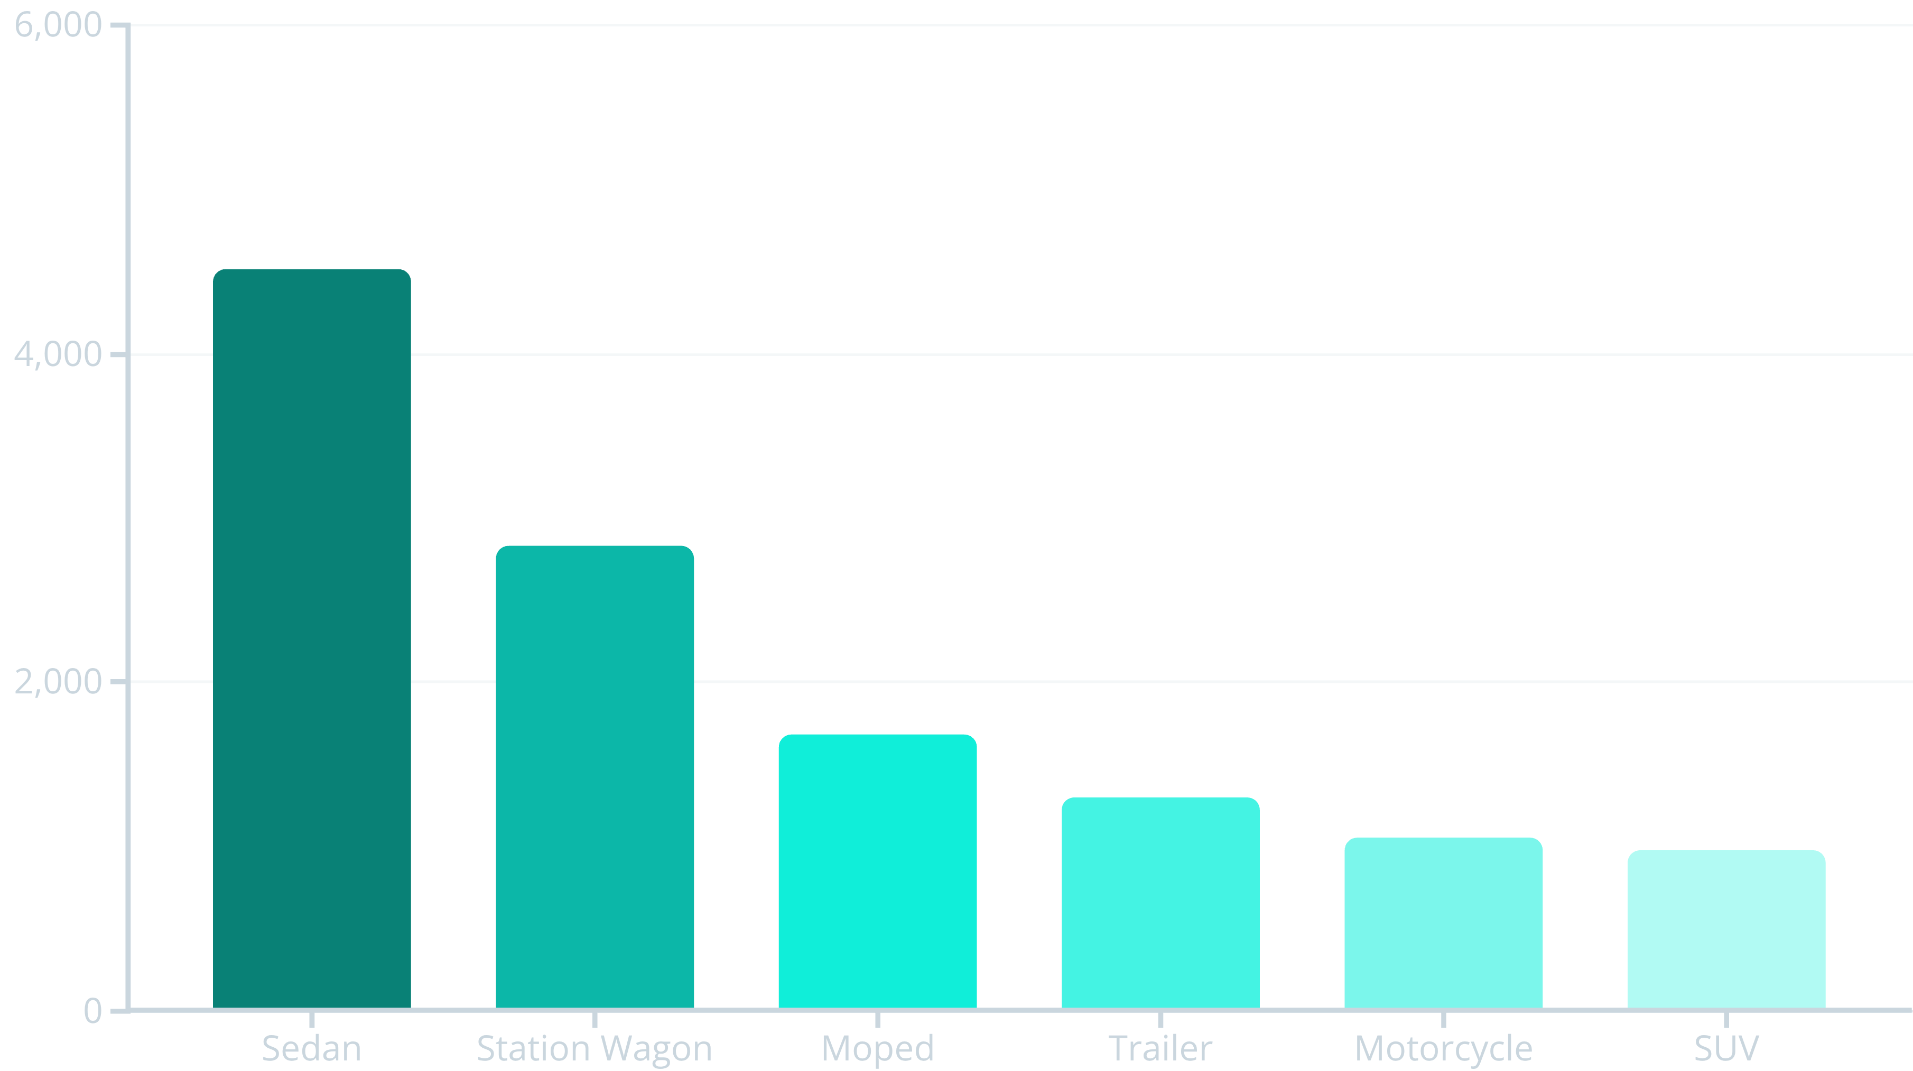
Vehicle Type Distribution
Query Analysis
SELECT vehicle_type, COUNT(*) AS theft_count
FROM stolen_vehicles
GROUP BY vehicle_type
ORDER BY theft_count DESC;
OUTPUT
Vehicle Type | Theft Count
Car | 5,320
Moped | 3,850
Roadbike | 2,410
Trailer | 1,120
Truck | 640
Insight: Sedans are the most stolen vehicle type at 37% of all thefts, followed by station wagons at 23%. Two-wheeled vehicles (mopeds and motorcycles) collectively represent 22% of thefts, highlighting their vulnerability due to portability and lower security features.

Slide 8
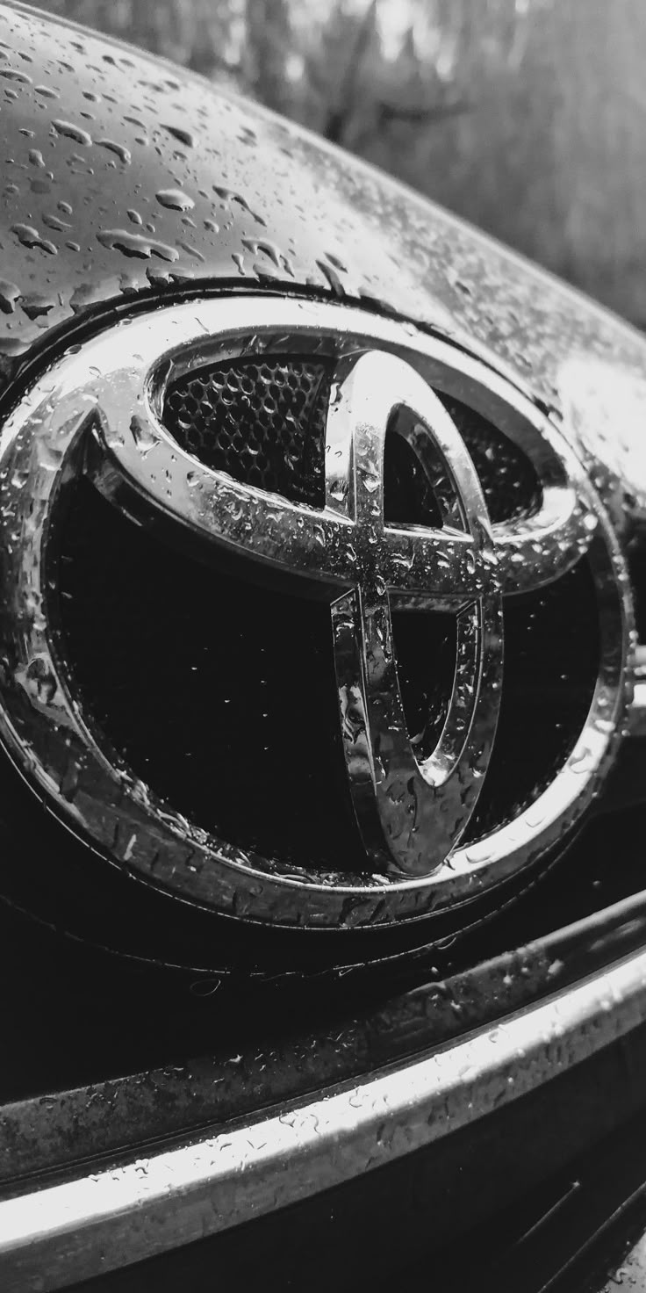

Most Targeted Vehicle Brand
Brand Vulnerability Analysis
SELECT m.make_name, COUNT(*) AS theft_count
FROM stolen_vehicles v
JOIN make_details m
ON v.make_id = m.make_id
GROUP BY m.make_name
ORDER BY theft_count DESC
LIMIT 1;
716
Toyota Theft
Total Toyota vehicles stolen, representing the highest theft count among all manufacturers
Implications
Why Toyota Leads
High market presence: Popular brand with large installed base increases opportunity
Toyota owners should invest in enhanced security measures including steering wheel locks, GPS tracking, and alarm systems. Law enforcement can focus surveillance on areas with high Honda concentrations.
Parts demand: Strong aftermarket creates incentive for theft and resale
Model consistency: Interchangeable parts across model years facilitate chop shop operations

Slide 9
Theft Rate Per Capita
Top 5 Regions Normalized by Population
SELECT l.region, COUNT(v.vehicle_id) AS total_thefts, ROUND((COUNT(v.vehicle_id) * 10000.0) / l.population, 2) AS thefts_per_10k
FROM stolen_vehicles v
JOIN locations l
ON v.location_id = l.location_id
GROUP BY l.region, l.population
ORDER BY thefts_per_10k DESC
LIMIT 5;
Region
Total Thefts
Rate per 10K
Gisborne
287
62.41
Northland
543
31.85
Bay of Plenty
987
28.73
Hawke's Bay
621
26.94
Manawatu
765
25.12
Critical Discovery: When adjusted for population, Gisborne emerges as the highest-risk region with 62.41 thefts per 10,000 residents—more than double Northland's rate. This reveals that absolute theft numbers don't tell the complete story; smaller regions can have disproportionately high theft rates requiring immediate intervention.

Slide 10
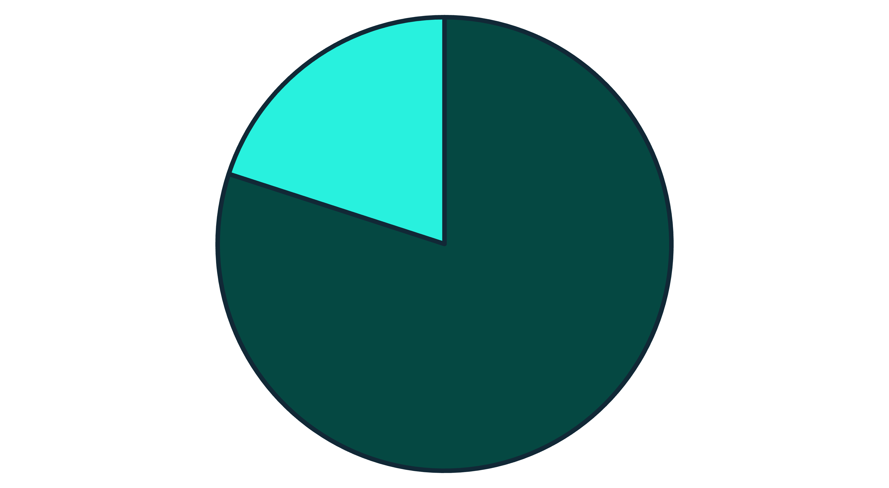

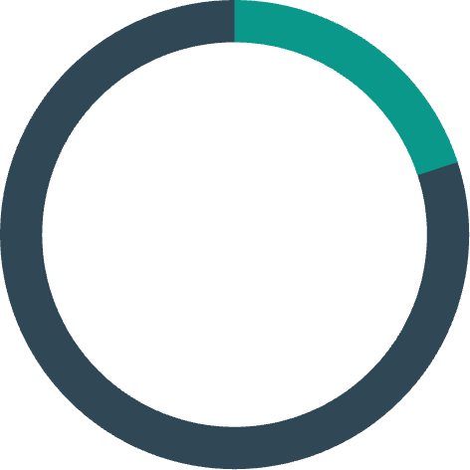
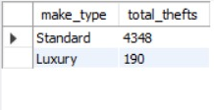
Luxury vs Standard Vehicle Comparison
Market Segment Analysis
SELECT m.make_type, COUNT(v.vehicle_id) AS total_thefts
FROM stolen_vehicles v
JOIN make_details m
ON v.make_id = m.make_id
GROUP BY m.make_type;
Standard
Luxury
Understanding whether thieves prefer luxury vehicles or target standard models reveals economic motivations and helps insurers assess risk profiles accurately.
80%
20%
Standard Vehicles
Luxury Vehicles
Key Takeaway: Standard vehicles are stolen four times more frequently than luxury models. This pattern suggests thieves prioritize accessibility and quick resale opportunities over high-value targets. Standard vehicles have weaker security systems, higher market volume for parts, and lower law enforcement attention compared to luxury brands with advanced anti-theft technology.
Comprise the vast majority of theft incidents
Represent a smaller but significant portion

Slide 11
Joins Analysis
Region-wise Vehicle Theft Summary
Auckland has the highest number of stolen vehicles — 1638 cases.
Canterbury ranks 2nd with 660 thefts.
Bay of Plenty and Wellington follow with 446 and 420 thefts respectively.
Waikato reported 371 thefts.
Northland, Gisborne, Manawatū-Whanganui, and Otago recorded moderate thefts (between 139–234).
Taranaki has the lowest vehicle theft count — 112.
Luxury Vehicles Stolen Per Region
SELECT l.region, COUNT(*) AS luxury_thefts
FROM stolen_vehicles v
JOIN make_details m
ON v.make_id = m.make_id
JOIN locations l
ON v.location_id = l.location_id
WHERE m.make_type = 'Luxury’
GROUP BY l.region
ORDER BY luxury_thefts DESC;
247
189
156
North Region
Central Region
South Region
Highest luxury vehicle thefts
Second highest luxury thefts
Moderate luxury theft activity

Slide 12

Thank You
Any Questions?
Ready to discuss insights, methodology, or explore additional analysis opportunities from our vehicle theft data investigation.

